Slide 1
Beyond FaaS
Stateful, Scalable, & Scrutable Cloud Apps with Orleans
@ReubenBond

Slide 2
Functions as a Service (FaaS)
Building block: stateless function
Practically: stateless request handlers
Like the HTTP controllers of old…
… but with nice input and output bindings
HTTP triggers, queue triggers, storage triggers, etc
Fully-managed platform!
Scale-to-zero, fine-grained billing
Great developer experience

Slide 3
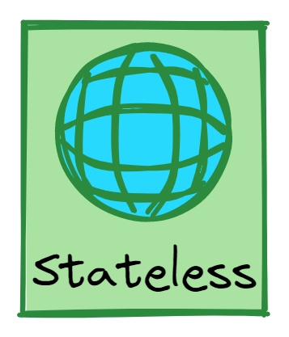
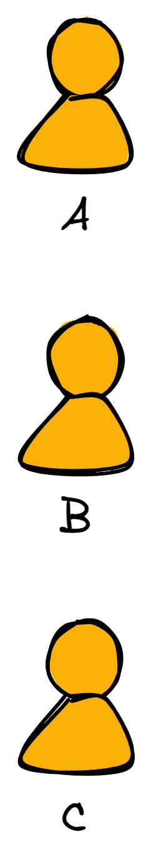
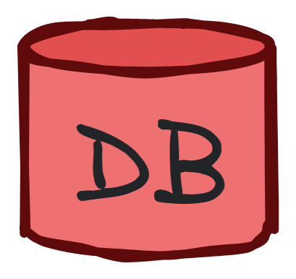




Slide 5
Slow access
High read load, high DB usage costs
Write conflict!

Slide 6
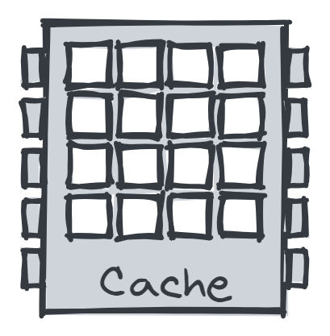

Slide 7
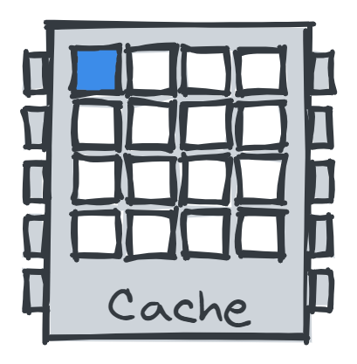
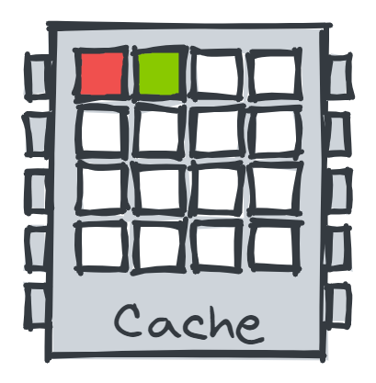

Slide 10
Dual read, dual write pattern
Consistency issues
Still have write contention!
Lots of code to handle data access & failure cases!

Slide 11
FaaS – the downsides to statelessness
High latency
High database load increases cost and hurts scalability
High write contention
With a cache:
Cache coherency & data consistency issues
Slower (dual) writes
Inefficient!
Statelessness is the root of these problems!

Slide 12
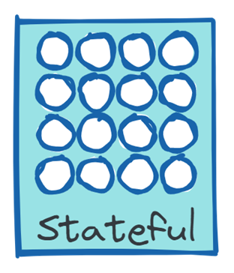
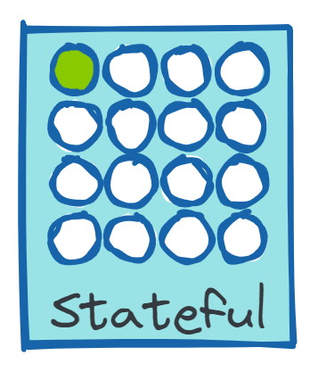
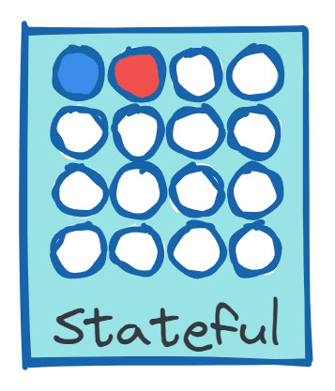

Slide 14
Fast, in-memory reads!

Slide 16
Write-through or write-behind
No write contention

Slide 17
What just happened?
stateless
functions
high latency
high DB load
high DB contention
consistency issues
→
→
→
→
→
→
stateful
objects
low latency
low DB load
low DB contention
no consistency issues

Slide 18
Stateless vs. Stateful Services
Stateless service
Load state from storage, execute request, write to storage if needed
Easiest to implement, no coordination across requests
Storage is the bottleneck
Caches help but complicate
Data shipping
Stateful service
Keep loaded state in memory
Route requests to the right server*
Write-through to storage
Serve read requests from memory, only touch storage on writes
*Gets complicated quickly if servers can fail or scale out/in
Function shipping
Frontends
Middle Tier
Cache
Storage

Slide 19
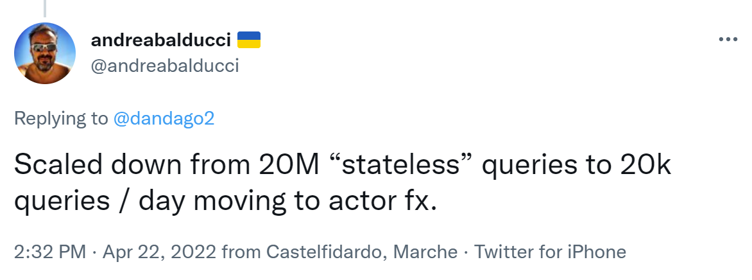
1000x decrease

Slide 20



Slide 21
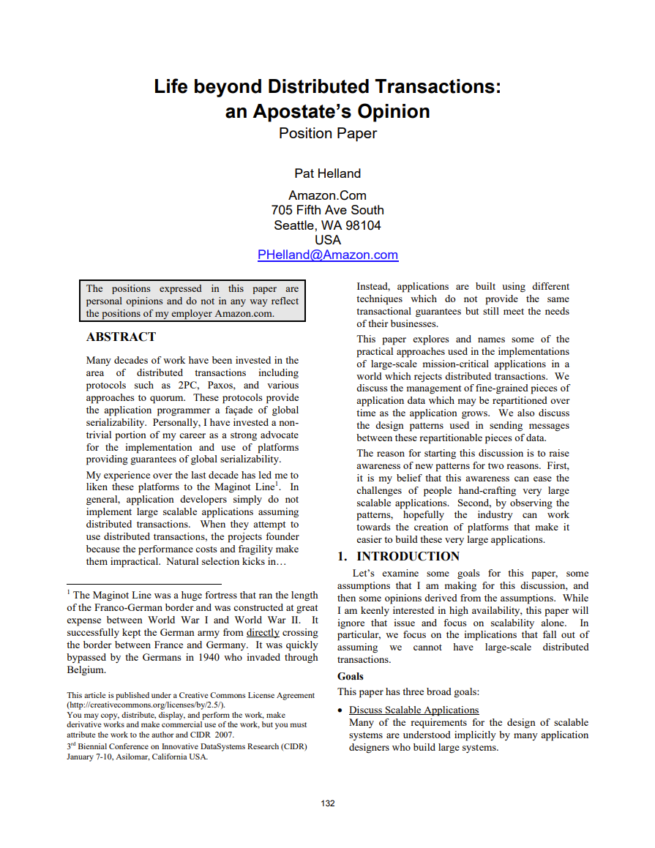
Divide system into Entities
Eg, an entity for each customer, order, product, etc
Each one has a unique ID
Eg, customer ID, order number, product SKU, etc
Entities encapsulate their own state
Cannot access entity state without messaging the entity
State always fits on a single machine
Messages are addressed to entities
Using the entity’s unique identifier, not a physical address

Slide 22
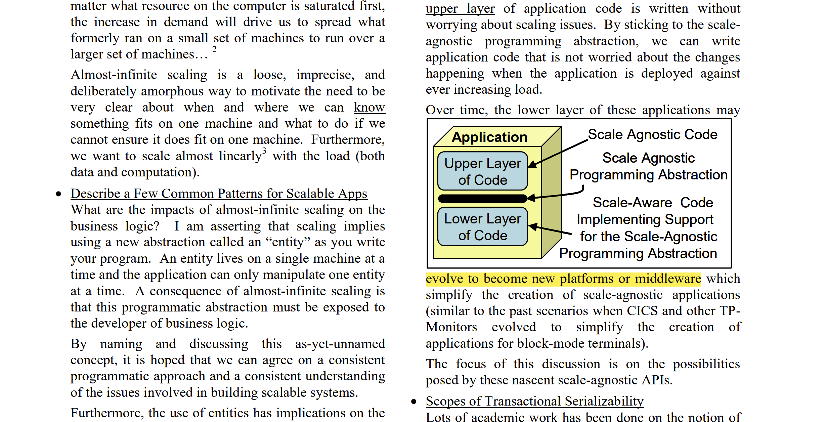
Application code is unaware of servers & scale
No notion of the scale of the application
No server addresses, only logical entity IDs
Location transparency!
Application code is stateful
Entities encapsulate their own state
Requests are routed to the entity with the relevant state

Slide 23
Application code is unaware of servers & scale
No notion of the scale of the application
No server addresses, only logical entity IDs
Location transparency!
Application code is stateful
Entities encapsulate their own state
Requests are routed to the entity with the relevant state
Is this stateful serverless!?

Slide 24
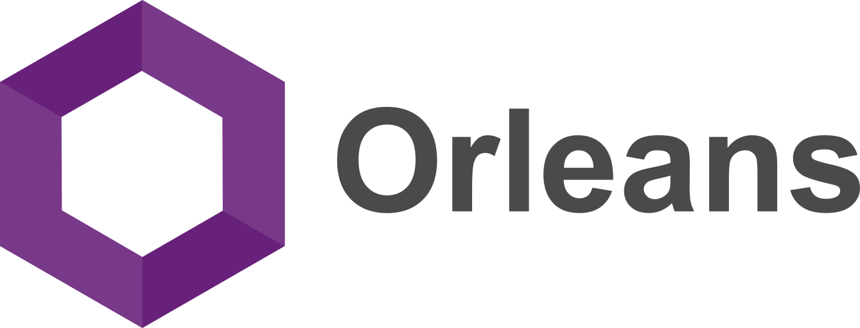

Slide 25
Microsoft Orleans
Framework for stateful, cloud-based applications
Programming model
Runtime
Building-block: grains (distributed objects)
Runtime handles scale out/in, fault tolerance, service discovery, load balancing, messaging, routing
From Microsoft Research, now part of .NET
Adopted by many Microsoft product groups & external companies, running in major production services for almost a decade

Slide 26
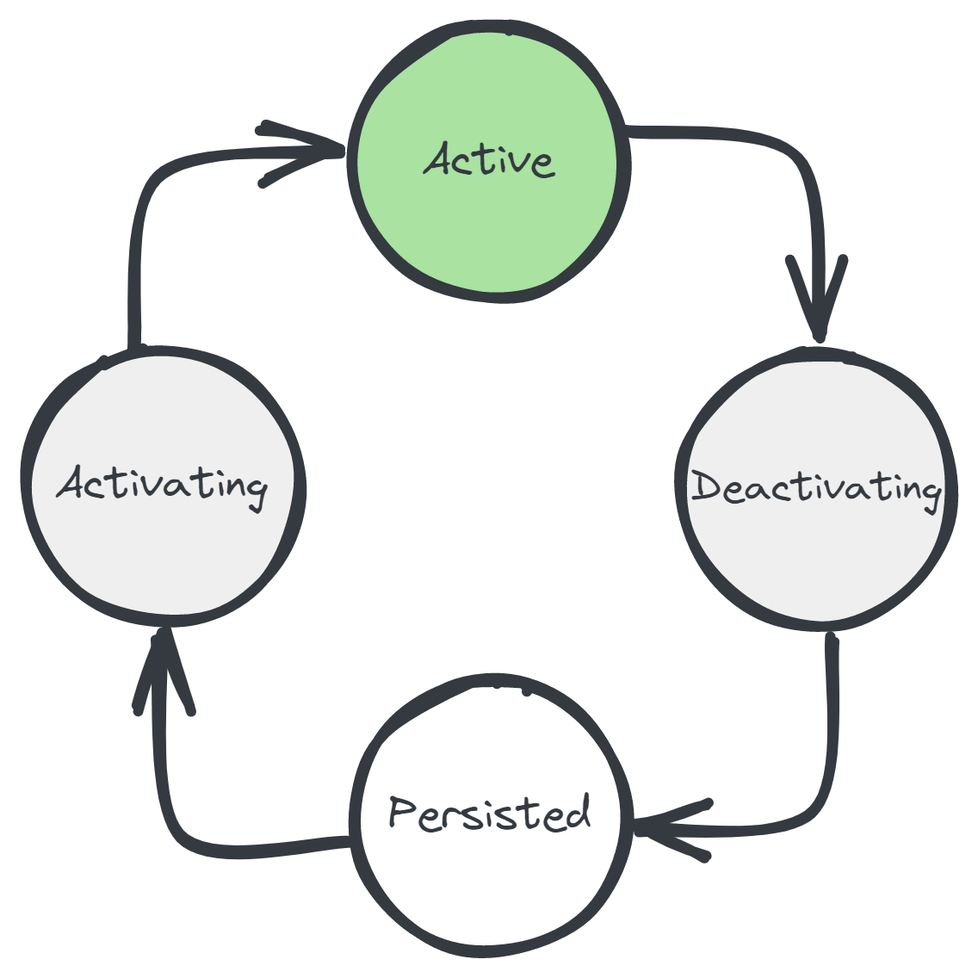
Grains
Distributed objects (virtual actors)
Each one has a unique ID, a class, & (persistent) state
Live forever, virtually
Managed lifecycle
Location-transparent
Communicate by messaging
Strongly-typed RPC interfaces
Single-threaded by default
try/catch error handling

Slide 27
Grains – Benefits
Less database reads
Hot/warm data is kept in-memory, cold data is in database
No need for a separate cache – great for soft state
Less database write contention
Each grain owns its own state
Less cache coherency issues
Writes update the grain’s state, grain updates the database
Grains act like a smart, write-through cache
Better scalability
Grains are spread out over your application instances
Low-latency writes
No need for async writes via a queue/worker
Simplicity!
Less code, less infrastructure, less error handling, less retry logic

Slide 28
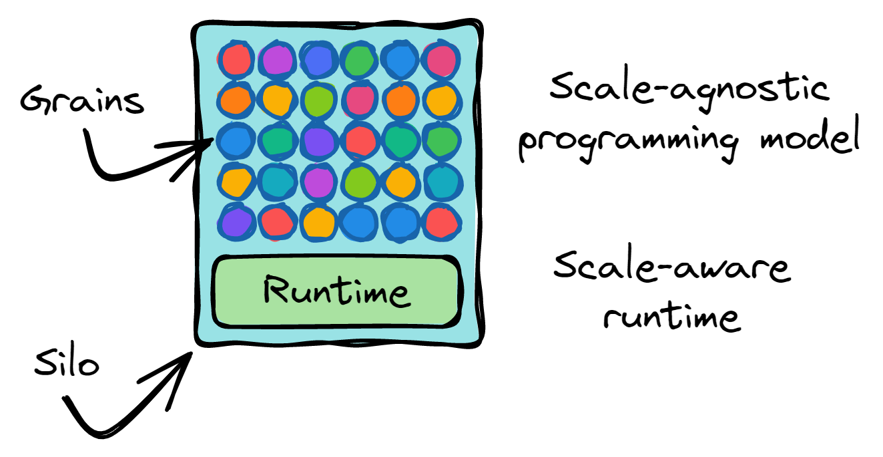
Programming Model + Runtime

Slide 29
Frontends
Orleans
Storage

Slide 30
Frontends
Orleans
Storage

Slide 31
Frontends
Orleans
Storage
ProbeRequest
ProbeRequest

Slide 32
Frontends
Orleans
Storage
ProbeResponse
ProbeResponse

Slide 33
Frontends
Orleans
Storage
ProbeRequest
ProbeRequest

Slide 34

Frontends
Orleans
Storage
ProbeRequest
ProbeRequest

Slide 35
Frontends
Orleans
Storage
ProbeRequest
ProbeRequest

Slide 36
Frontends
Orleans
Storage

Slide 37
public interface IUserGrain : IGrainWithStringKey
{
Task SendMessage(IUserGrain from, string msg);
Task<List<Message>> GetMessages();
}

Slide 38
public class UserGrain : Grain, IUserGrain
{
IPersistentState<List<Message>> _msgs;
public UserGrain([PersistentState("msgs")] IPersistentState<List<Message>> state)
=> _msgs = state;
public Task<List<Message>> GetMessages() => Task.FromResult(_msgs.State);
public async Task SendMessage(IUserGrain sender, string body)
{
_msgs.State.Add(new Message { Sender = sender, Body = body });
await _msgs.WriteStateAsync();
}
}
We never loaded the state…
Methods are always single-threaded

Slide 39
// Get grain references. Synchronous & cheap
IUserGrain me = client.GetGrain<IUserGrain>("reuben");
IUserGrain friend = client.GetGrain<IUserGrain>("JotB");
// Call them
await friend.SendMessage(me, "hey :)");
var messages = await me.GetMessages();

Slide 40
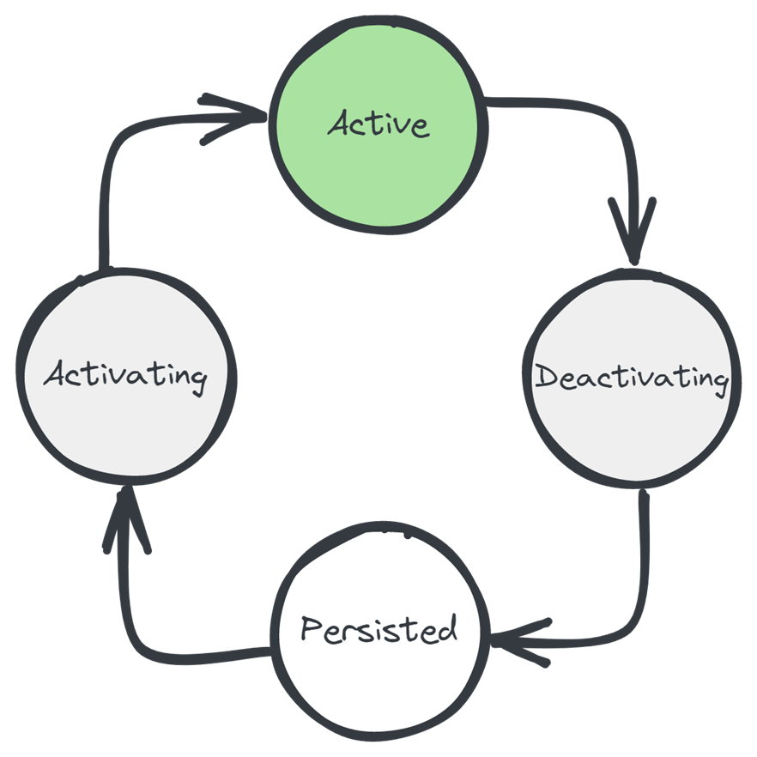
Managed lifecycle

Slide 41

"hi :)"
A
try
{
await friend.SendMessage(me, "hi :)");
}
catch (Exception exception)
{
Console.WriteLine(
$"Message failed, was I blocked?! {exception}");
}
!!!
"hi :)"
!!!
Distributed
asynchronous
try/catch
semantics!
B
"hi :)"
!!!
C

Slide 42
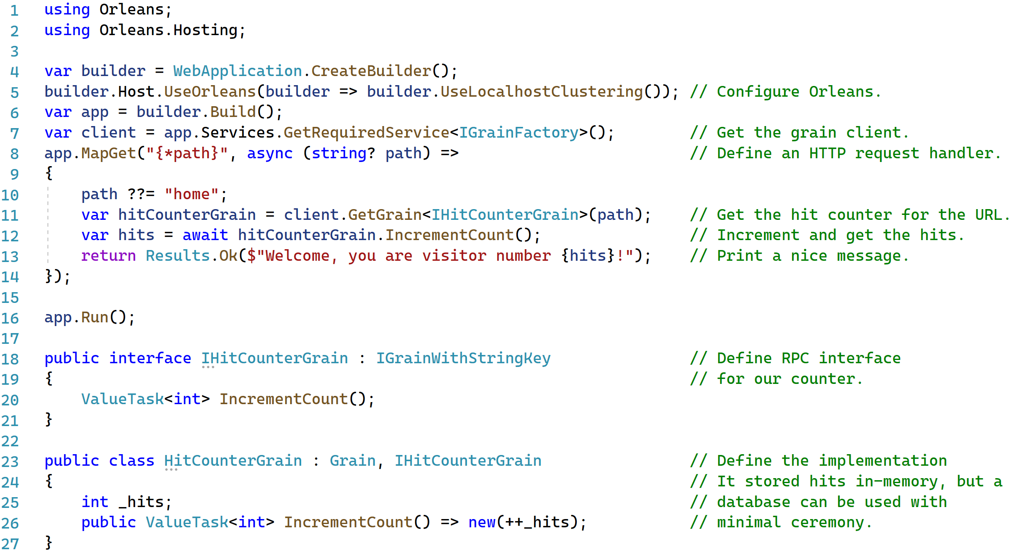
"hi :)"
A
try
{
await friend.SendMessage(me, "hi :)");
}
catch (Exception exception)
{
Console.WriteLine(
$"Message failed, was I blocked?! {exception}");
}
!!!
"hi :)"
!!!
Distributed
asynchronous
try/catch
semantics!
B
"hi :)"
!!!
C

Slide 43
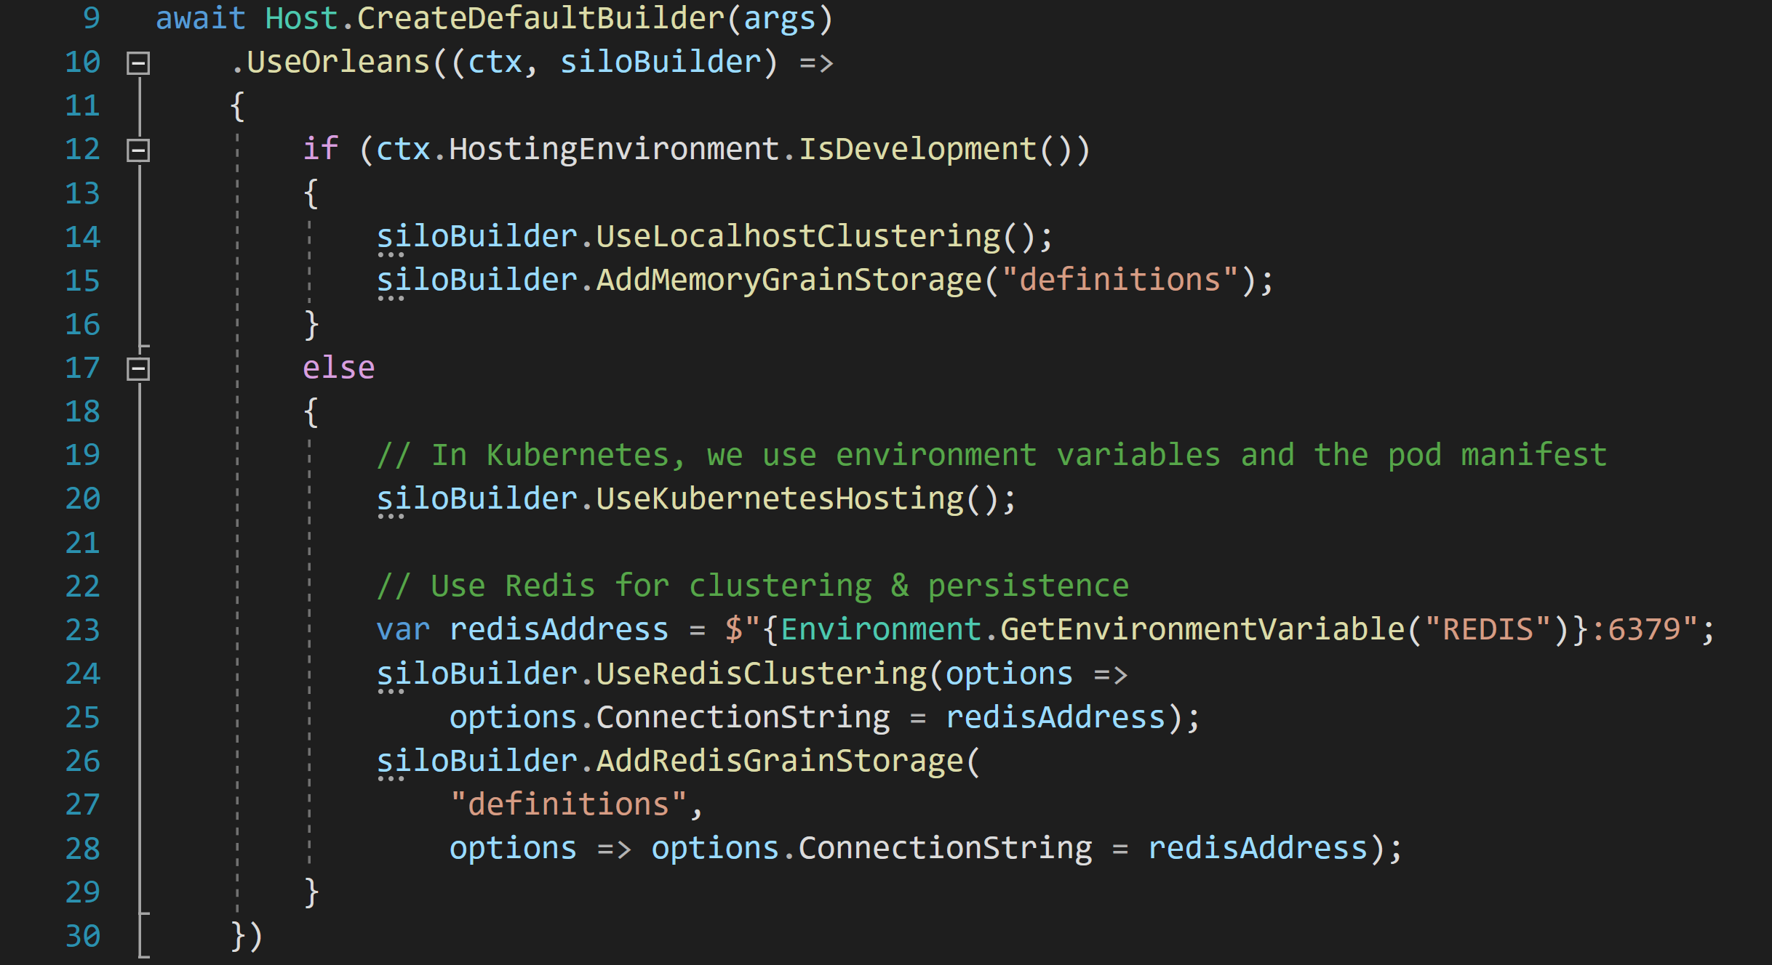

Slide 44

Azure PlayFab
Azure IoT Digital Twins
Microsoft
Mesh
Microsoft Teams
Skype
Orleans
Xbox Game Studios
& Xbox Publishing
Azure Active Directory
Azure Quantum
Dynamics 365 Fraud Protection
Azure
Machine Learning

Slide 45
Orleans Features
Persistence
Plugins for Azure Storage, Cosmos DB, SQL, DynamoDB, Redis, MongoDB, …
Distributed ACID transactions
Read/write state in multiple grains transactionally
Virtual streams
Decouple producers & consumers. Backed by Azure Event Hubs, Amazon SQS, GCP, in-memory
Timers & reminders
Ephemeral timers, persistent reminders for scheduling future event
Observers
Grains can send events (RPC calls) directly to clients. Eg, push notifications, streams
Transport layer security
Mutual TLS between clients and the cluster as well as nodes within the cluster
Deployment freedom
Azure, AWS, GCP, on-prem, Kubernetes, Azure App Service, Windows, Linux, macOS
Custom placement & directory
Customize how the runtime decides where new grains are instantiated & how it finds them. “Move computation to data”
Call filters
Wrap incoming & outgoing requests & responses for logging, tracing, error handling
.NET integration
DI/Logging/Hosting/Configuration

Slide 46
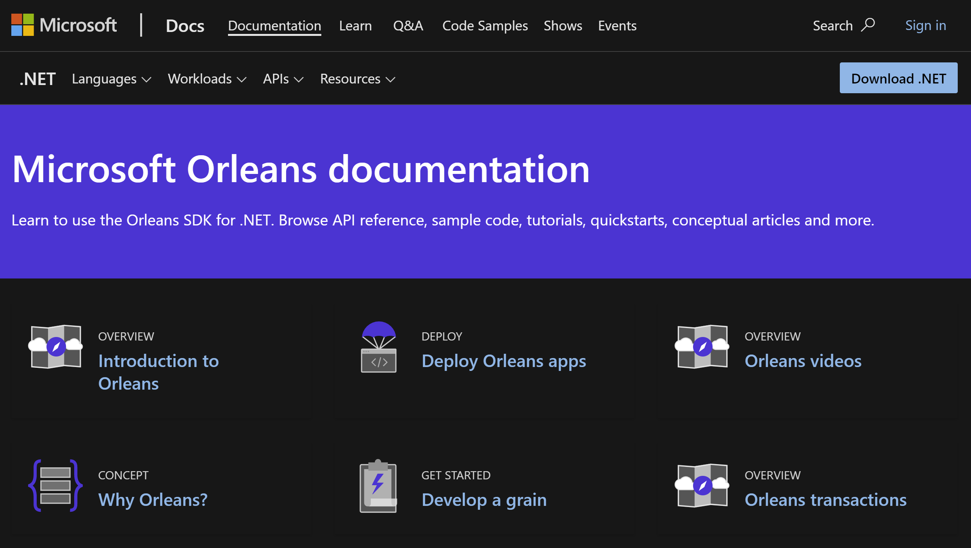
https://docs.microsoft.com/dotnet/orleans

Slide 47
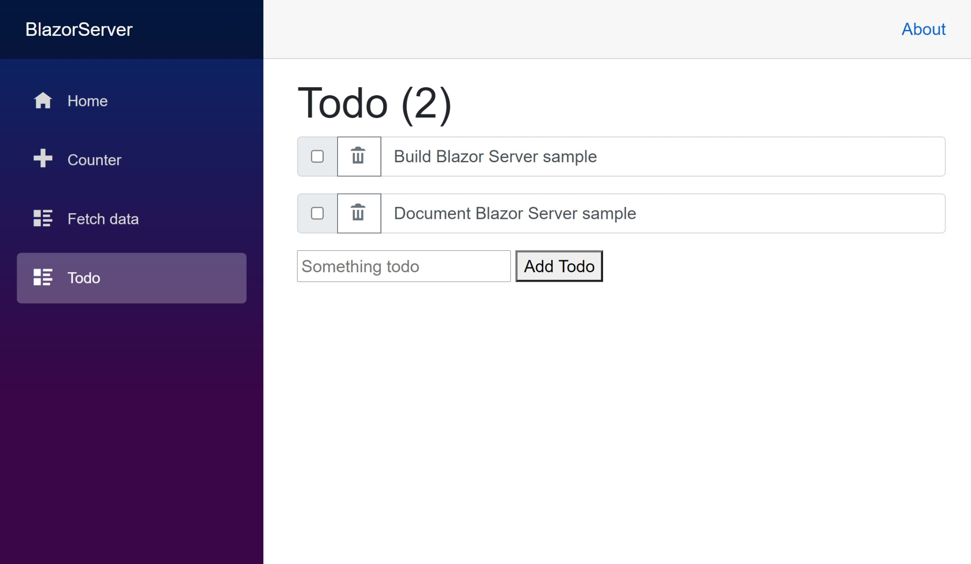
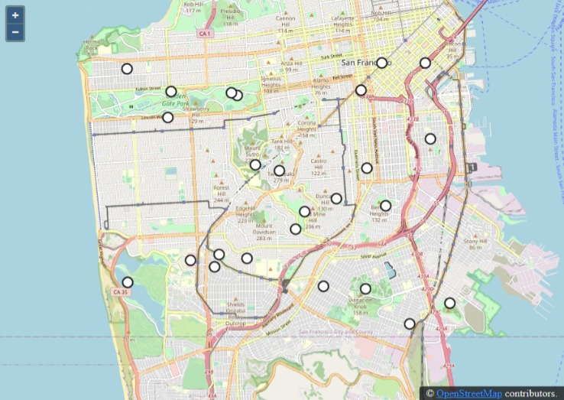
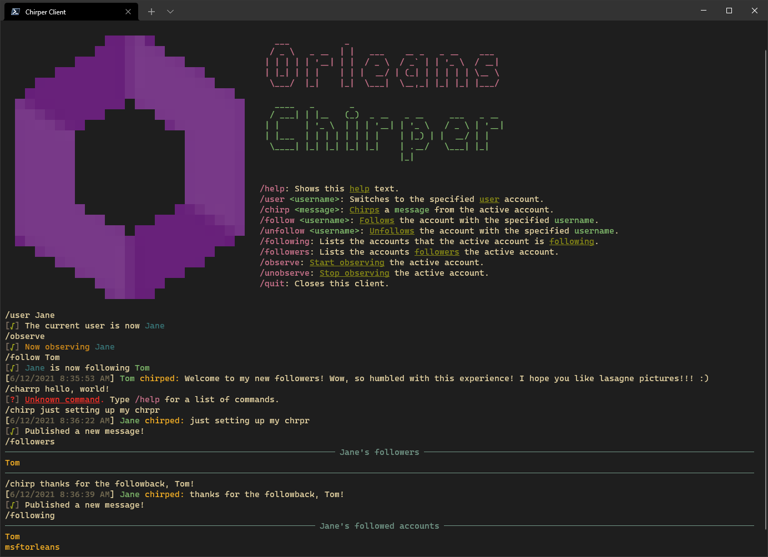
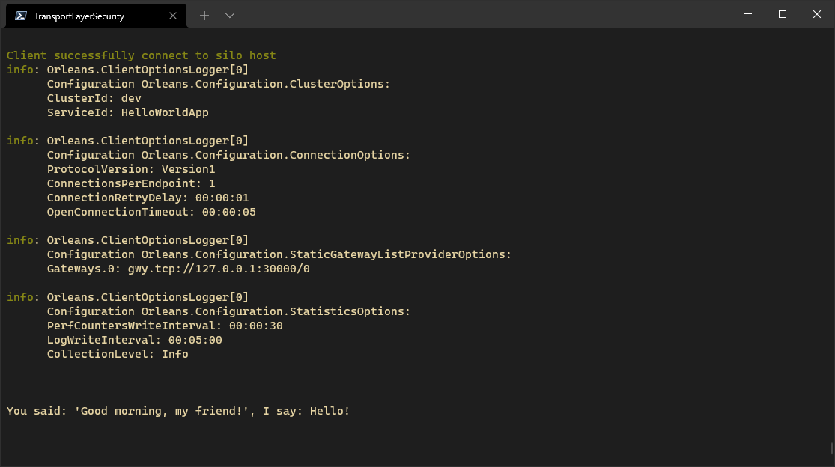
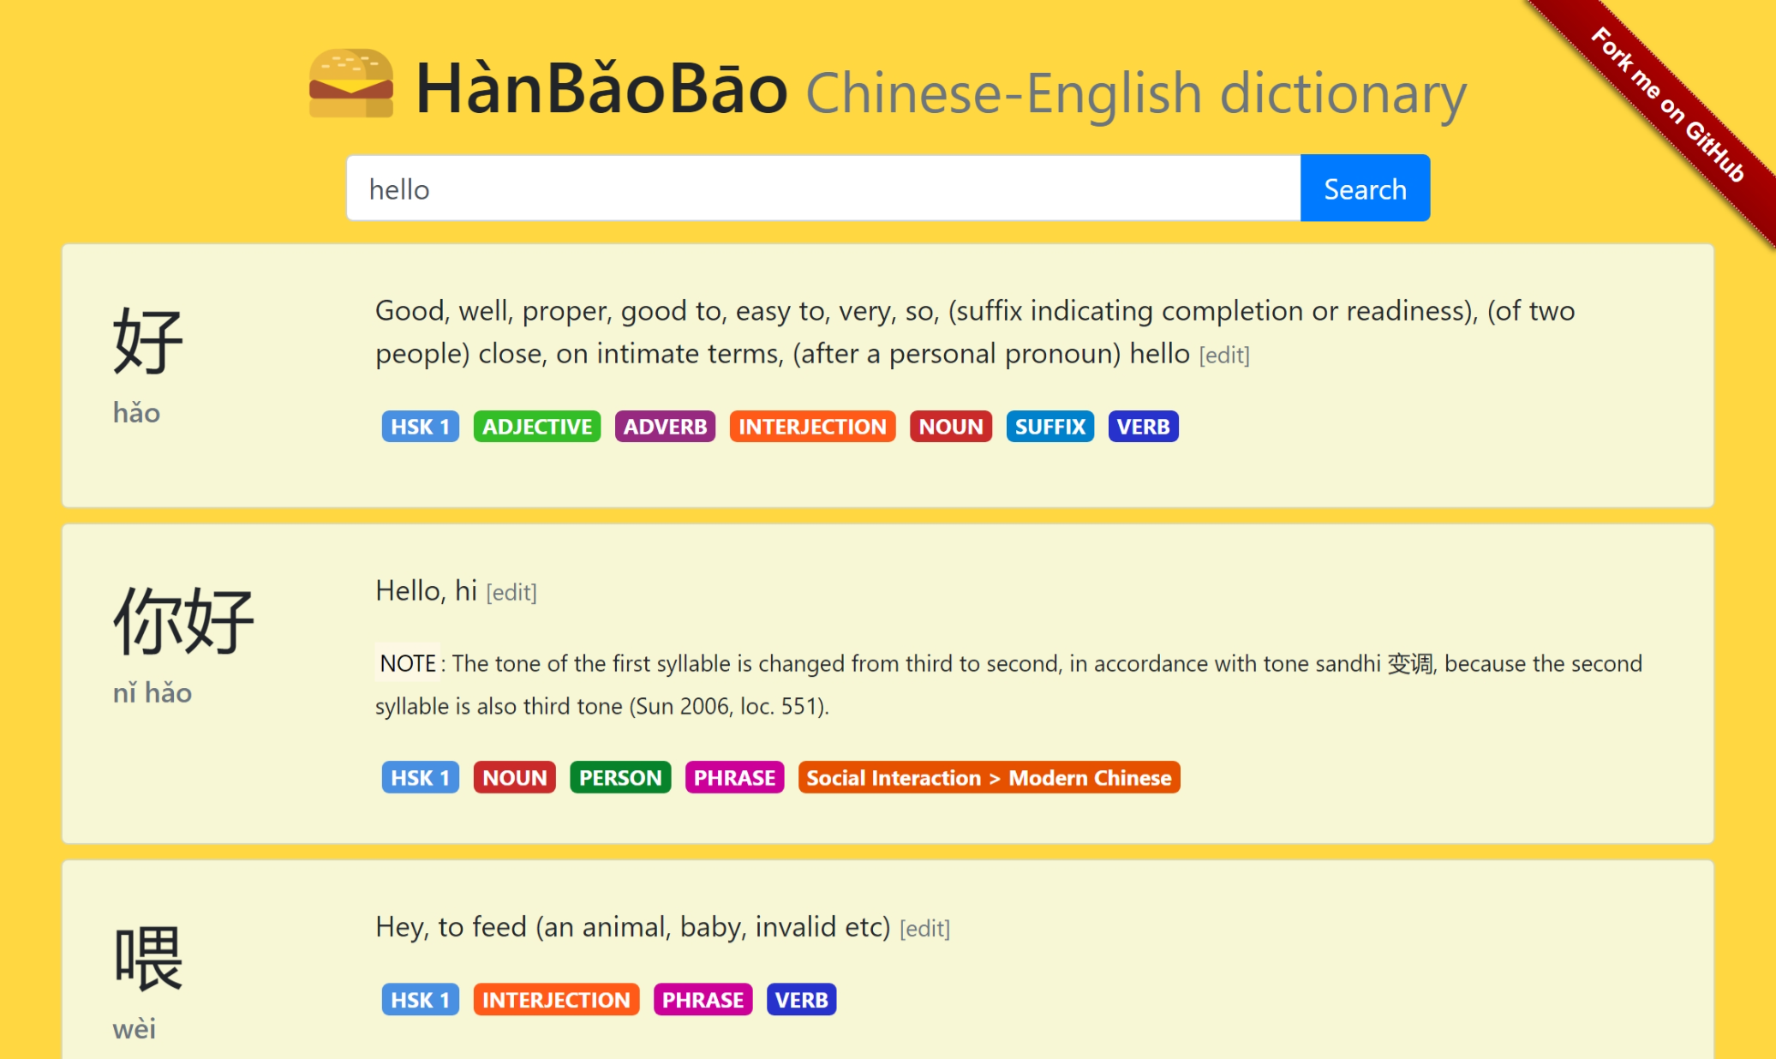
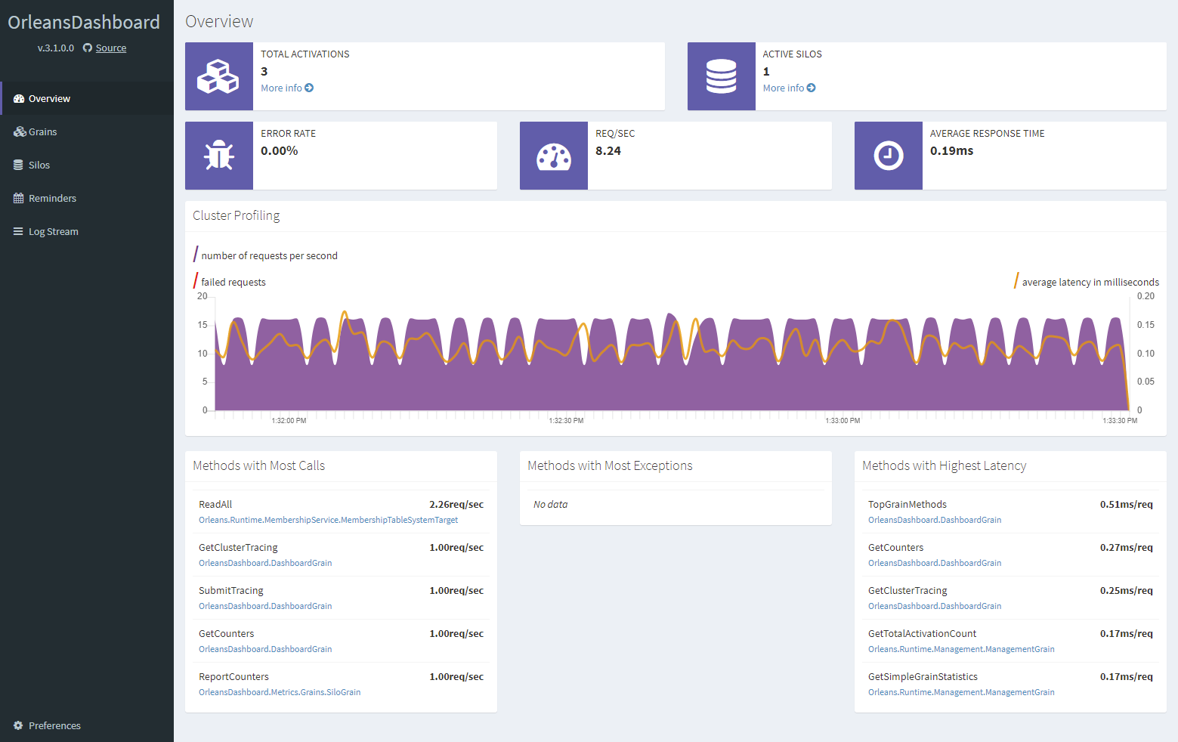
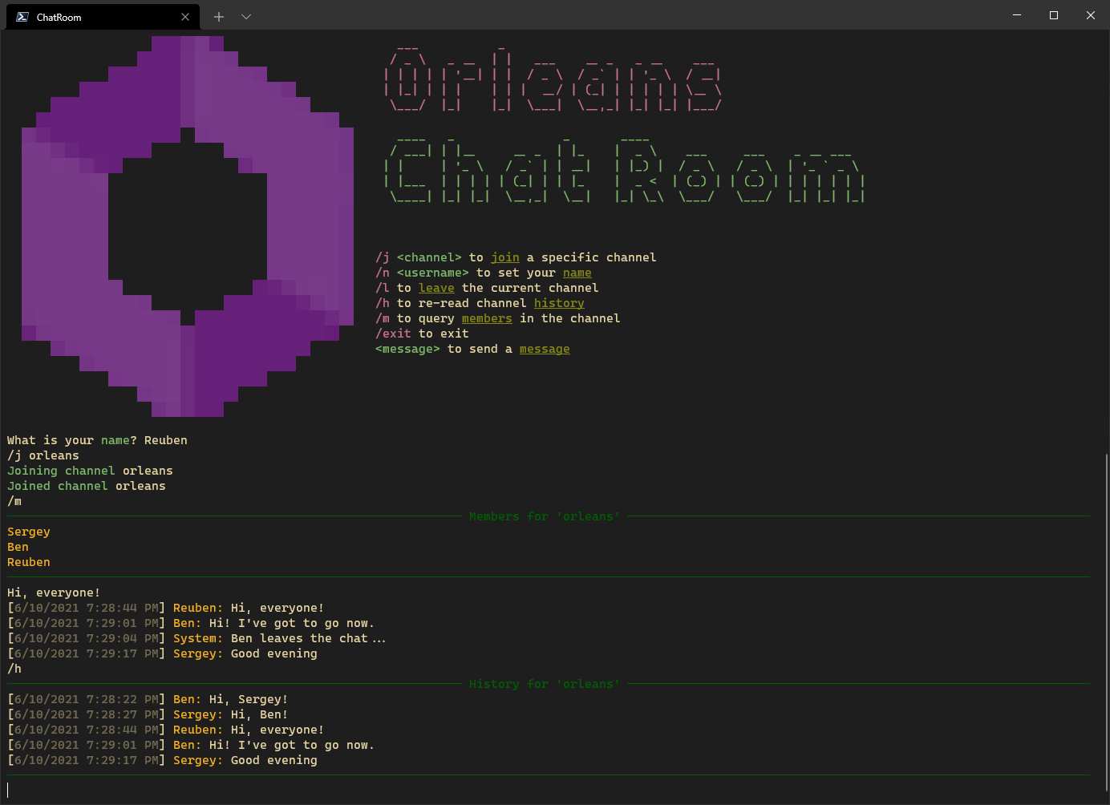
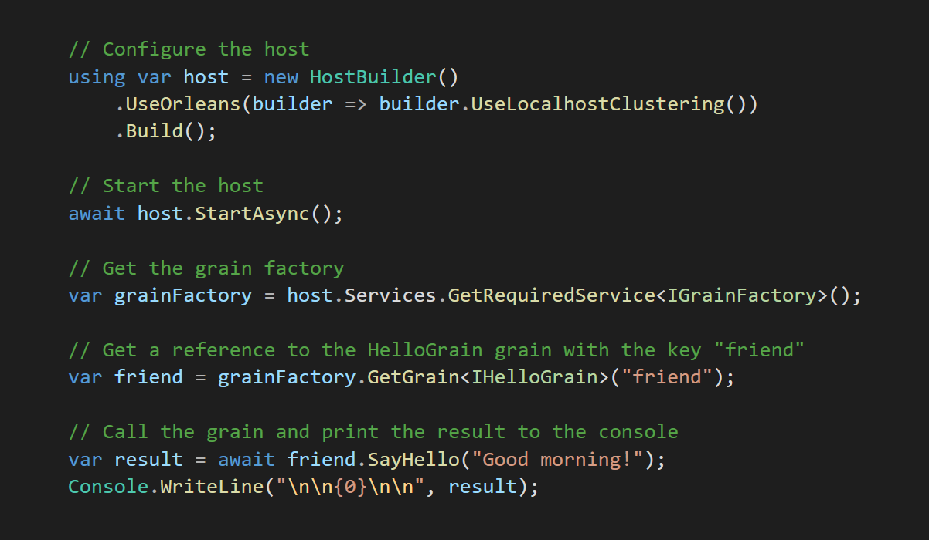
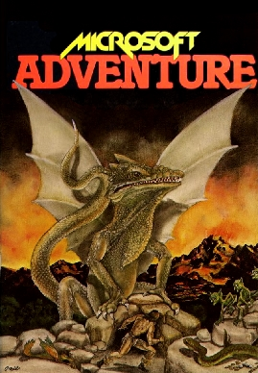
https://aka.ms/orleans-samples

Slide 48


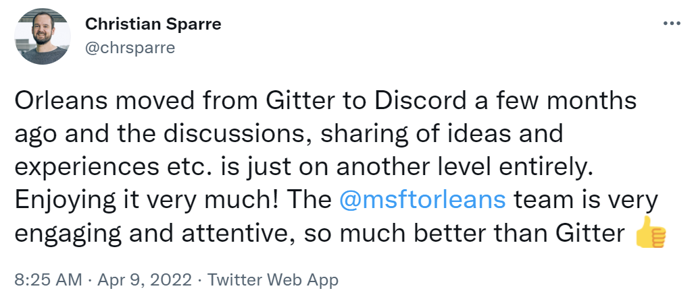

github.com/dotnet/orleans
aka.ms/orleans-discord
#JOTB22
@msftorleans
@ReubenBond

Slide 49
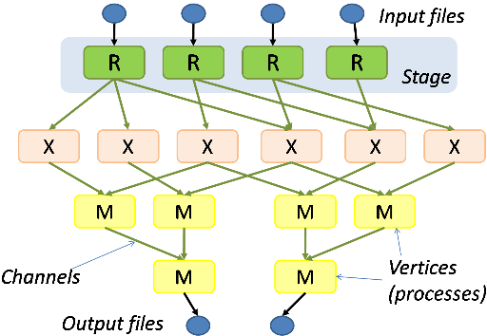
Restrictions can grant you superpowers
2004 Google publishes MapReduce
A new industry is invented, with tools like Hadoop (2005)
2007 Microsoft publishes Dryad
More general & expressive (DAGs)
2010 Apache Spark released as OSS
Developed in response to limitations in MapReduce.
Introduces the concept of working sets, relaxing restrictions even further

Slide 50
Other features
Generic grains, generic methods
Polymorpism, cyclic graphs
Low

Slide 51
What is serverless?
Consumption-based billing?
Managed infrastructure?
Scale-in and scale-out based on request load?
Scale-to-zero?
Functions as a Service?
Having zero servers?

Slide 52
Serverless in the abstract
Abstract away the notion of a server
Programming model is scale-agnostic
Can’t lift-and-shift your on-premises apps to serverless
Can’t even lift-and-shift most Cloud Native apps to serverless!

Slide 53
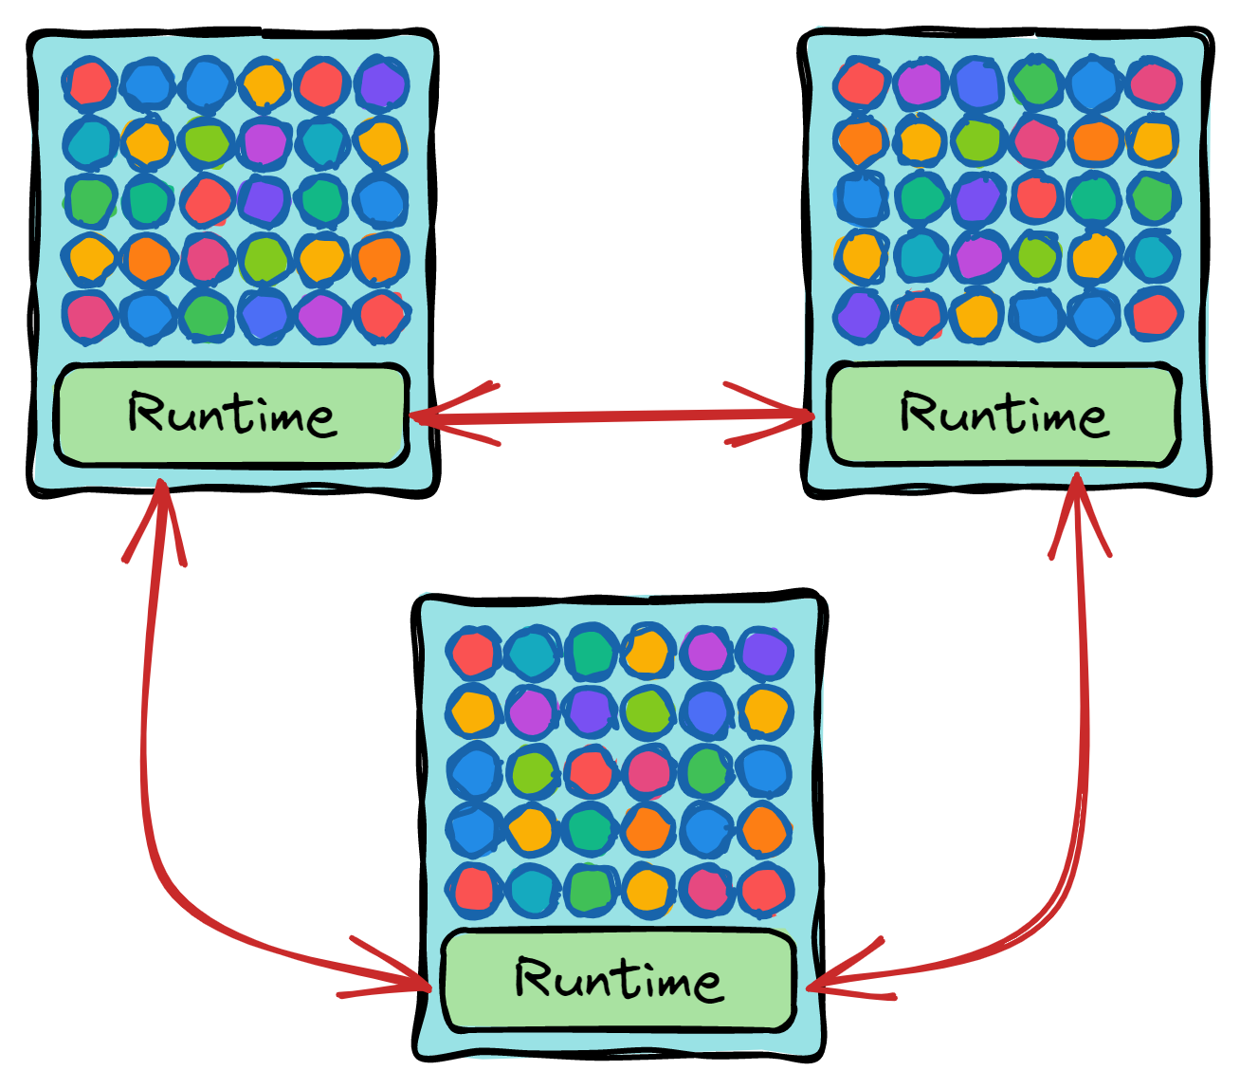

Slide 54
Grains = Entities
Grains are objects with stable identities
Encapsulate state
Multiple storage providers can be used
No direct external access
Excellent scalabilty
“Almost-infinite scaling”

Slide 55
Microsoft Orleans
Framework for cloud-native applications
Programming Model
Runtime
From Microsoft Research, now part of .NET
Runs just about anywhere
Linux, Windows, macOS
Bare metal, Kubernetes, App Service…
Azure, AWS, GCP
Used for
Halo, Gears of War, Azure ML, Azure IoT, Dynamics 365 Fraud Protection, Azure PlayFab, Xbox Publishing, Microsoft Mesh, etc

Slide 56

How do the cloud giants do it?

Slide 57



Slide 58

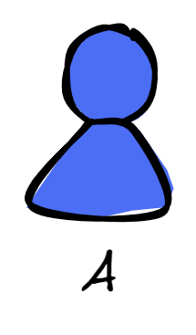

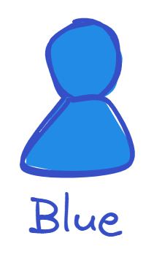



Slide 60
FaaS is overly restrictive
Scalability
High latency
Cache coherency
Expressiveness
Excessive code dedicated to data management in
Lack of structured composition

Slide 61

State Management

Slide 62
Stateless versus stateful

Slide 63
Building stateful apps (the old way)

